Slide 1
Steel Story
Lesson 2 – moles in gas and solution(synoptic)

Slide 2
Objectives
Must
Recall the molar volume of gases at STP and RTP
Should
Carry out calculations involving gas volumes, concentrations of solutions, volumes of solution and moles
Could
Calculate reacting volumes of gas in balanced equations

Slide 3
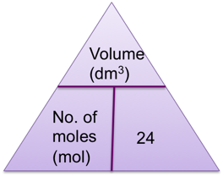
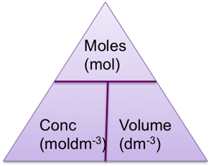
Starter
Draw all arrangements of the formulae below;
Gas phase
Number of moles = volume (in dm³)
24
Liquid phase
Moles = concentration x volume

Slide 4
Specification statements
Use the concept of amount of substance to perform calculations involving;
Molecular formulae,
Masses of reagents,
Percentage yields,
Volumes of gases,
Volumes of solutions of known concentrations,
Balanced chemical equations

Slide 5
Theory – moles of gas
Molar volume – This is the volume per mole of gas molecules.
When quoting the molar volume it is important to give the temperature as this effects the volume the gas occupies.
At Standard Temperature (273K) and Pressure (STP) this value is 22.4 dm³
At Room Temperature (298K) and Pressure (RTP) this value is 24 dm³

Slide 6
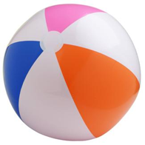
What is 24 dm³?
This is about the size of a beach ball
It is interesting that the molar volume is the same for every gas.
1 Mole
Hydrogen
1 Mole
nitrogen
1 Mole
oxygen

Slide 7
Questions – finding moles
Find the number of moles of molecules in the following gaseous volumes at room temperature;
240 cm³ of Helium
480 cm³ of carbon dioxide CO₂
480 dm³ of sulfur dioxide SO₂
1200 cm³ of methane CH₄
1.2 cm³ of propane C₃H₈

Slide 8
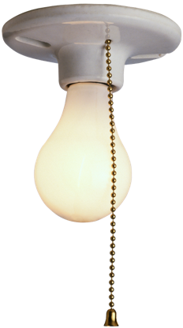
Answers
Moles = (240/1000)/24 = 0.010 mol
0.020 mol
20 mol
0.050 mol
0.000050 mol or 5.0 x 10⁻⁵ mol

Slide 9
Questions – finding volumes
What is the volume occupied by each of the following gases at room temperature;
4.0g of hydrogen molecules H₂
3.2g of methane CH₄
0.00048g of ozone O₃
17.6kg of carbon dioxide CO₂
6.8 tonnes of ammonia NH₃

Slide 10
Answers
Moles = mass moles = volume
Mr 24 (RTP)
Moles of H₂ molecules = 4.0g/2 = 2 mol volume = moles x 24 = 2 x 24 = 48 dm³
4.8 dm³
0.24 cm³
9600 dm³
9,600,000 dm³

Slide 11
AfL – using whiteboards
Find the number of moles of molecules in 96cm³ of uranium (VI) fluoride. Show your working
What is the volume occupied by 4.0g of Argon atoms

Slide 12
Answers
0.0040 mol
2.4 dm³

Slide 13
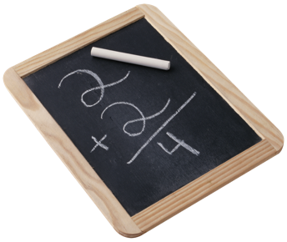
Calculation – reacting volumes
Worked example
A volume of 134.4dm³ of pure hydrogen is reacted with excess nitrogen in the presence of an iron catalyst. The reaction is carried out at STP. Assuming the reaction goes to completion, what volume of ammonia is produced?

Slide 14
Step 1 – Write a balanced equation
3H₂ + N₂ → 2NH₃
Step 2 – Calculate number of moles of known substance
Moles of hydrogen = 134.4 dm³
22.4
=6 mol
Step 3 – Deduce reaction ratio from equation
3 moles of H₂ produces 2 moles of NH₃
so 6 moles of H₂ will produce 4 moles of NH₃.
Step 4 – Convert number of moles into volume
4 moles of NH₃ = 4 x 22.4 dm³ = 89.6 dm³

Slide 15
Group work
In your groups answer the following question.
Propane burns in oxygen. What is minimum volume of oxygen required to completely combust 25dm³ of propane at STP?

Slide 16
Answer
C₃H₈ (g) + 5O₂ (g) → 3CO₂ (g) + 4H₂O (g)
One mole of any gas occupies a volume of 22.4 dm³ at STP
Moles of C₃H₈ = 25/22.4 = 1.116 mol
This reacts with 5 times as many moles of O₂
5 x 1.116 = 5.58 mol
Volume of gas = 5.58 x 22.4 = 125 dm³

Slide 17
Exam question
Calcium carbonate, CaCO₃, reacts with hydrochloric acid as shown in the equation below.
CaCO₃(s) + 2HCl (aq) → CaCl₂(aq) + H₂O(l) + CO₂(g)
7.50 × 10^{–3} mol CaCO₃ reacts with 0.200 mol dm^{–3} HCl.
(i) Calculate the volume, in cm³, of 0.200 mol dm^{–3} HCl required to react with 7.50 × 10^{–3} mol CaCO₃.
answer = ................................................. cm³ [2]
(ii) Calculate the volume, in cm³, of CO₂ formed at room temperature and pressure.
answer = ................................................. cm³ [1]
[Total 3 marks]

Slide 18
Answers with indicative marks
(i) Moles of HCl = 1.50 × 10^{–2} mol (1)
volume of HCl (aq) = 75.0 cm³ (1)
ALLOW answers to 2 significant figures
ALLOW ecf from wrong number of moles i.e ALLOW one mark for 37.5 (from incorrect 1:1 ratio)
(ii) 180 (1)
No other acceptable answer [3]

Slide 19
Exam question
In 2000, the mass of CO₂ emitted in the UK was equivalent to 1 kg per person in every hour.
Calculate the volume of 1 kg of carbon dioxide. Assume that 1 mole of CO₂ occupies 24 dm³.
volume = .......................... dm³ [2]
The UK has set a target to cut CO₂ emissions by 60% of the 2000 value by 2050. Calculate the reduction needed in the volume of CO₂ emissions each hour per person if the target is to be met.
answer: ........................... dm³ [1]
[Total 3 marks]

Slide 20
Answer
(i) moles CO₂ = 1000 /44 mol = 22.7 mol (1) volume CO₂ in 2000 = 22.7 x 24 = 545 dm³ (1)
(ii) reduction = (545 x 60)/100 = 327 dm³ (1)
[3]

Slide 21
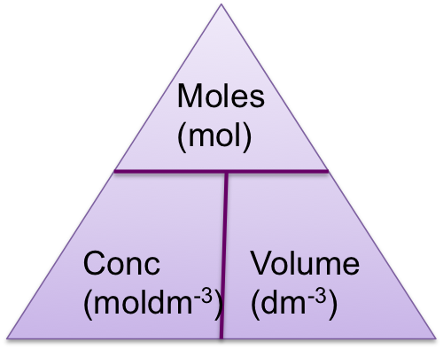
Theory – concentration of solutions
When the volume of a solution and the number of moles are known , the concentration can be calculated using the equation;
Moles = concentration (moldm⁻³) x volume (dm³)

Slide 22
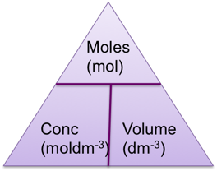
Questions
Calculate the number of moles present in each of the following;
25.0 cm³ of 0.1 moldm⁻³ hydrochloric acid
1.5 dm³ of 2.5 moldm⁻³ sodium hydroxide
3.0 cm³ of 2.0 moldm⁻³ sulfuric acid
20.0cm³ of 0.17 moldm⁻³ barium hydroxide
11.2cm³ of 0.5 moldm⁻³ sodium carbonate solution

Slide 23
Answers
25.0/1000 x 0.1 mol = 0.0025 mol
3.75 mol
0.006 mol
0.0034 mol
0.0056 mol

Slide 24
Exam question
A student carries out a titration to find the concentration of some sulfuric acid. The student finds that 25.00 cm³ of 0.0880 mol dm^{–3} aqueous sodium hydroxide, NaOH, is neutralised by 17.60 cm³ of dilute sulfuric acid, H₂SO₄.
H₂SO₄(aq) + 2NaOH(aq) → Na₂SO₄(aq) + 2H₂O(l)
(i) Calculate the amount, in moles, of NaOH used.
answer = ................................... mol [1]
(ii) Determine the amount, in moles, of H₂SO₄ used.
answer = ................................... mol [1]
(iii) Calculate the concentration, in mol dm^{–3}, of the sulfuric acid.
answer = ................................... mol dm^{–3} [1]

Slide 25
Answers
(a) (i) Calculate correctly 0.0880 x25.0/1000 = 2.2x10⁻³ OR 0.00220 mol
ALLOW 0.0022 OR 2.2 × 10^{–3} mol (1)
(ii) Calculates correctly 0.0022/2 = 1.10 × 10^{–3} mol OR 0.00110 mol
ALLOW 0.0011 OR 1.1 × 10^{–3} mol (1)
ALLOW ECF for answer (i)/2 as calculator value or correct rounding to 2 significant figures or more but ignore trailing zeroes
(iii) 0.00110 x 1000/17.60 = 0.0625 moldm⁻³ OR 6.25 × 10^{–2} mol dm^{–3} (1)
ALLOW 0.063 OR 6.3 × 10^{–2} mol dm^{–3}
ALLOW ECF for answer (ii) × 1000/17.60OR ECF from (i) for answer (i)/2 × 1000/17.60 as calculator value or correct rounding to 2 significant figures or more but ignore trailing zeroes

Slide 26
Summary
Recall the molar volume of gases at STP and RTP
Calculate reacting volumes of gas in balanced equations
Carry out calculations involving gas volumes, concentrations of solutions, volumes of solution and moles

